Slide 1
Simulation Analysis Hotel Management and Efficient Staffing Models
DATA604: Simulation and Modeling Techniques
Final Project Presentation

Slide 2
Project Description
Simulation analysis to analyze the efficiency and effectiveness of a hotel. Tools used:
Simio, a dynamic simulation tool, is used to run the simulation.
Statistical models were run in R using RStudio for reproduction.
Efficiency
Measured by utilization of servers and workers
Effectiveness
Measured by profit estimates

Slide 3
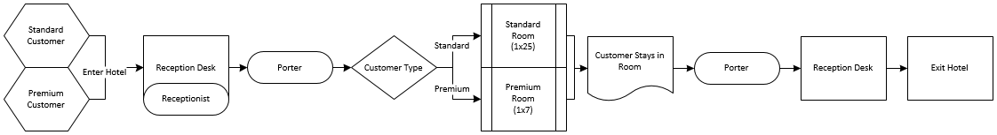
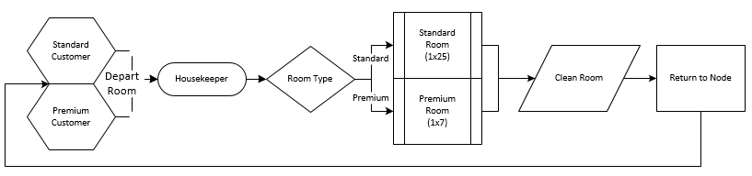
Process Models
1. Guests
1. Housekeepers

Slide 4
Model Inputs
Random Time Estimates Used
Incoming Guests
Guest Entry Times: Random, Triangular, min=7, mode=15, max=28 (minutes)
Probability of a Premium Guest: 15%
Guests per Arrival: Triangular, min=1, mode=2, max=3 (guests)
Reception
Check-In Times: Random, Triangular, min=4, mode=6, max=14 (minutes)
Check-Out Times: 0 minutes
Guest Stay Durations
Random, Uniform, min=6, max=10 (hours)
Room Cleaning Times
Standard Rooms: Triangular, min=5, mode=14.6, max=28 (minutes)
Premium Rooms: Standard Rooms + 3 (minutes)
Porter speed
Random, Lognormal, normal mean=0.927, normal standard deviation=0.264 (meters per minute, with each path being 1 meter)

Slide 5
Model Inputs (Cont’d)
Revenues and Expenses
Staff wages
Receptionists: $10.55 per hour
Porters: $10.74 per hour
Housekeepers: $10.16 per hour
Room Costs
Room Fixed Costs*: $425 per room per day
*Room Fixed Costs were moved upwards from $250 after high-level maximum and minimum profit calculations, so that minimum profit would realize a loss instead of a profit.
Room Revenues
Standard Rooms: $150 per Guest
Premium Rooms: $250 per Guest

Slide 6
Model Inputs (Cont’d 2)
Staff Schedules
Receptionists
Model 1: Three 8-hour shifts, 2 receptionists between 12:00am and 8:00am, 3 afterward
Model 2 & Model 3: Three 8-hour shifts, 3 receptionists all day
Porters
Model 1 & Model 2 & Model 3: Three 8-hour shifts with 1 Porter all day
Housekeepers
Model 1 & Model 2 & Model 3: Three 8-hour shifts with 3 housekeepers all day

Slide 7
Statistical Model: Min and Max
Expenses (using Model 1 scheduling)
$14,776.80
Profit Minimum Estimate
Used maximum durations of all random distributions*
*Set porter speed to 1 minute, standard
Loss: ($2,740.33)
Profit Maximum Estimate
Used minimum durations of all random distributions*
*Set porter speed to 1 minute, standard
$6,803.58

Slide 8
Statistical Model: Revenue & Utilization
Profit Estimate
Durations
Used random inputs generated using multiple distribution functions in R
Guests
The models were run for a 24 hour period, so 1440 minutes estimated cut-off
This limited our statistical model to 100 guests, 15% were estimated Premium guests
Profits
Revenues: For 100 guests, and 15% Premium guests, $16,500
Expenses: No change in expense estimate, $14,776.80
Profits: $1,723.20

Slide 9
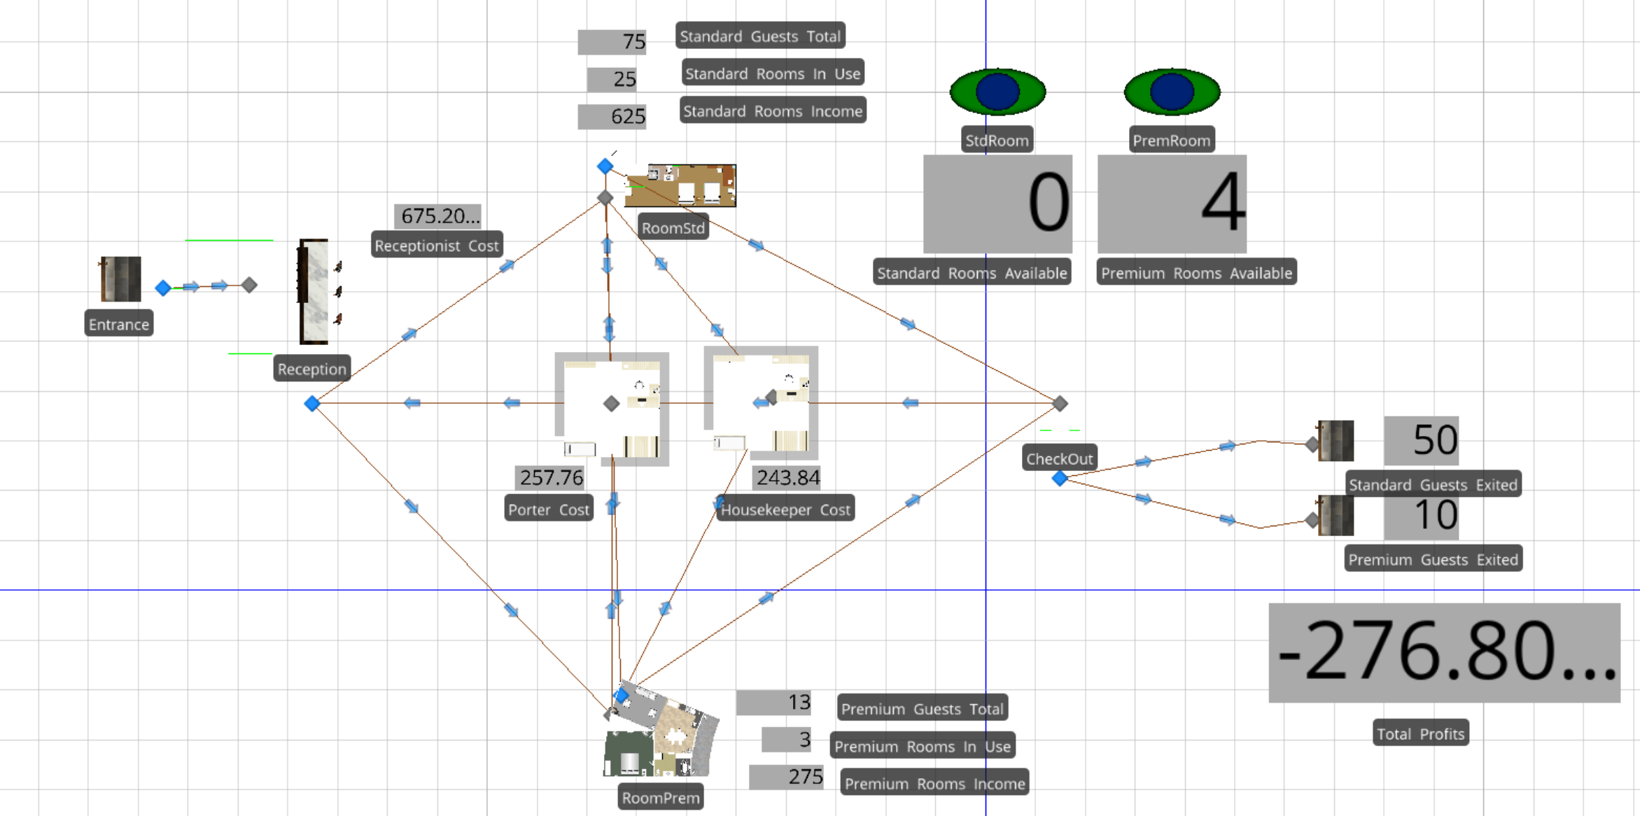
Simulation Model 1: On-Demand

Slide 10
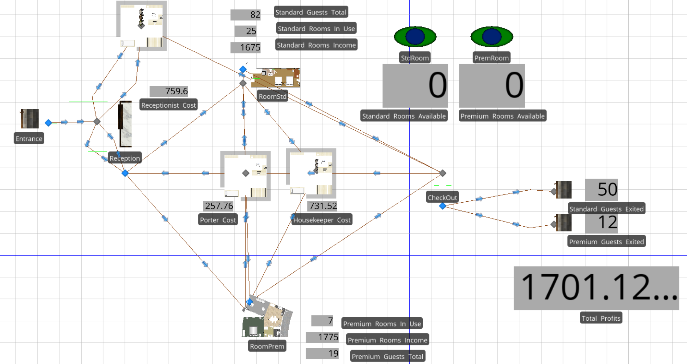
Simulation Model 2: Multitasking Reception

Slide 11

Simulation Model 3: Model 2 Adjusted

Slide 12
Comparison of the Models
Model | Statistical | Model 1 | Model 2 | Model 3
Profit | Est.: $1,723.20 ? Min: ($2,740.33) Max: $6,803.58 | $723.19 | $1,701.12 | $201.12
Standard Guests | 85 (?) | 70 | 82 | 72
Premium Guests | 15 (?) | 20 | 19 | 19
Housekeeper Utilization | 54% (?) | 62% | 22% (8% + 20% + 38%) | 20% (8% + 16% + 37%)
Receptionist Utilization* | NA | N/A | <1% (1% + 0.15% + 0%) | (0% + 0% + 0%)
Reception Utilization | 1% (?) (can’t be right)­­­­­­ | 68% | 57% | 57%
Porter Utilization | 10% (?) | 8% | 7% | 8%

Slide 13
Resources and Links
Resource Name | Description | Link
GitHub Folder | GitHub folder including models, R code, images, and this document. | https://github.com/chrisgmartin/DATA604-Final
Statistical Model Support | RPubs website hosting the support for the Statistical Model | http://rpubs.com/chrisgmartin/data604_final_statmodel

